Slide 1
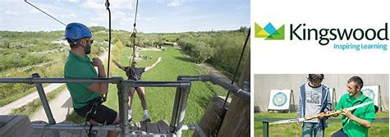

PGL 20th – 22nd MAY 2026
Depart school at 9:15am

Slide 2
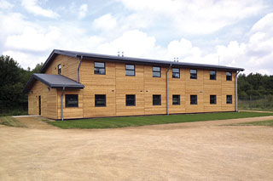
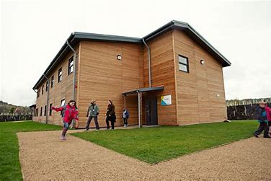
Your home: secure dorms

Slide 3
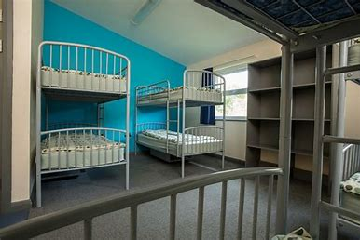
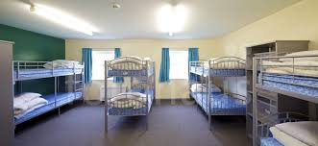
Bedrooms sleep up to 10

Slide 4
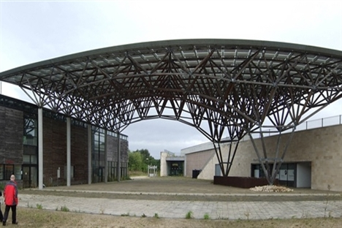
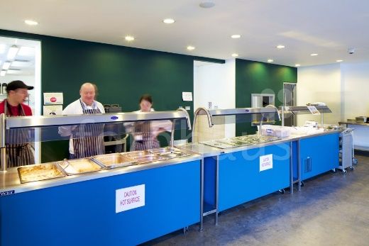
Dining Hall
3 meal choices

Slide 5
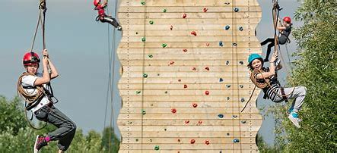
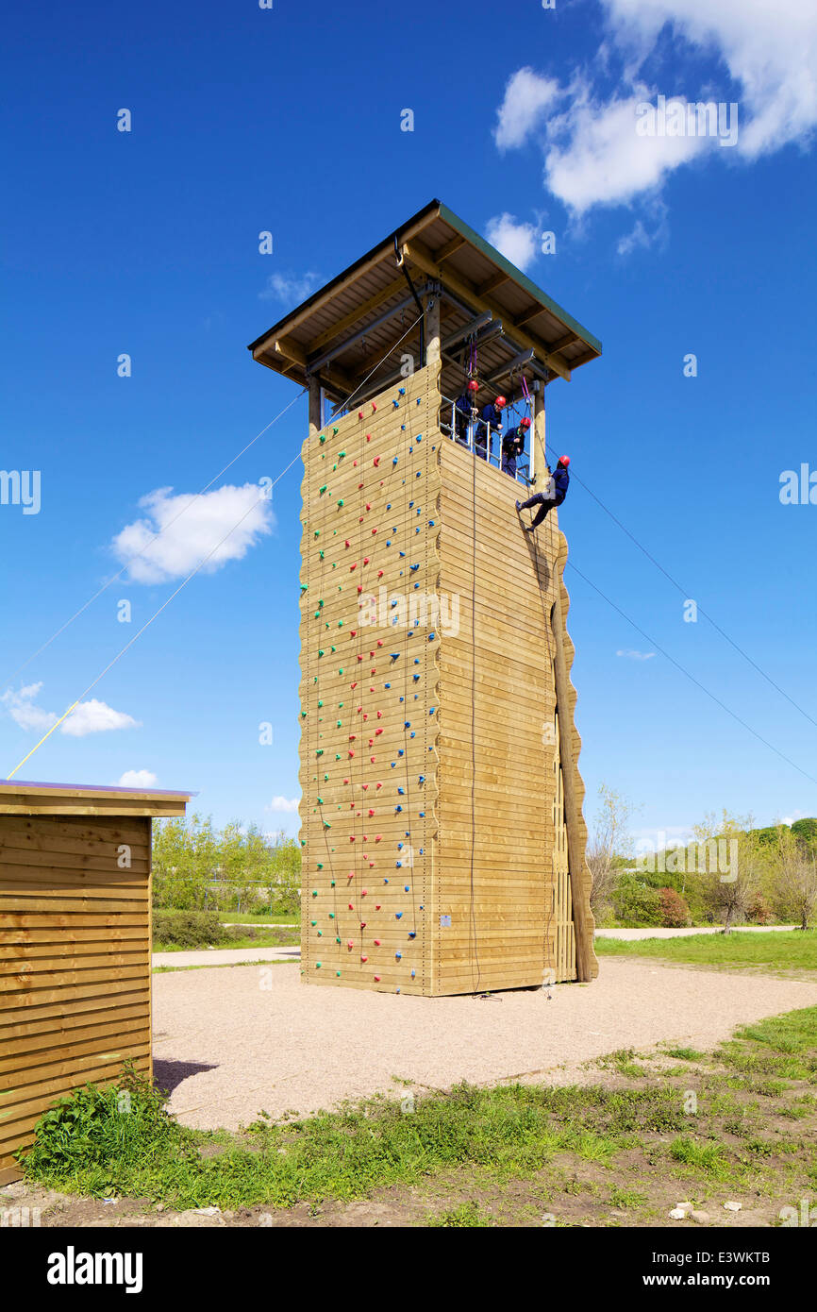
Activities
Adventure
Teamwork
Challenge
Fun

Slide 6
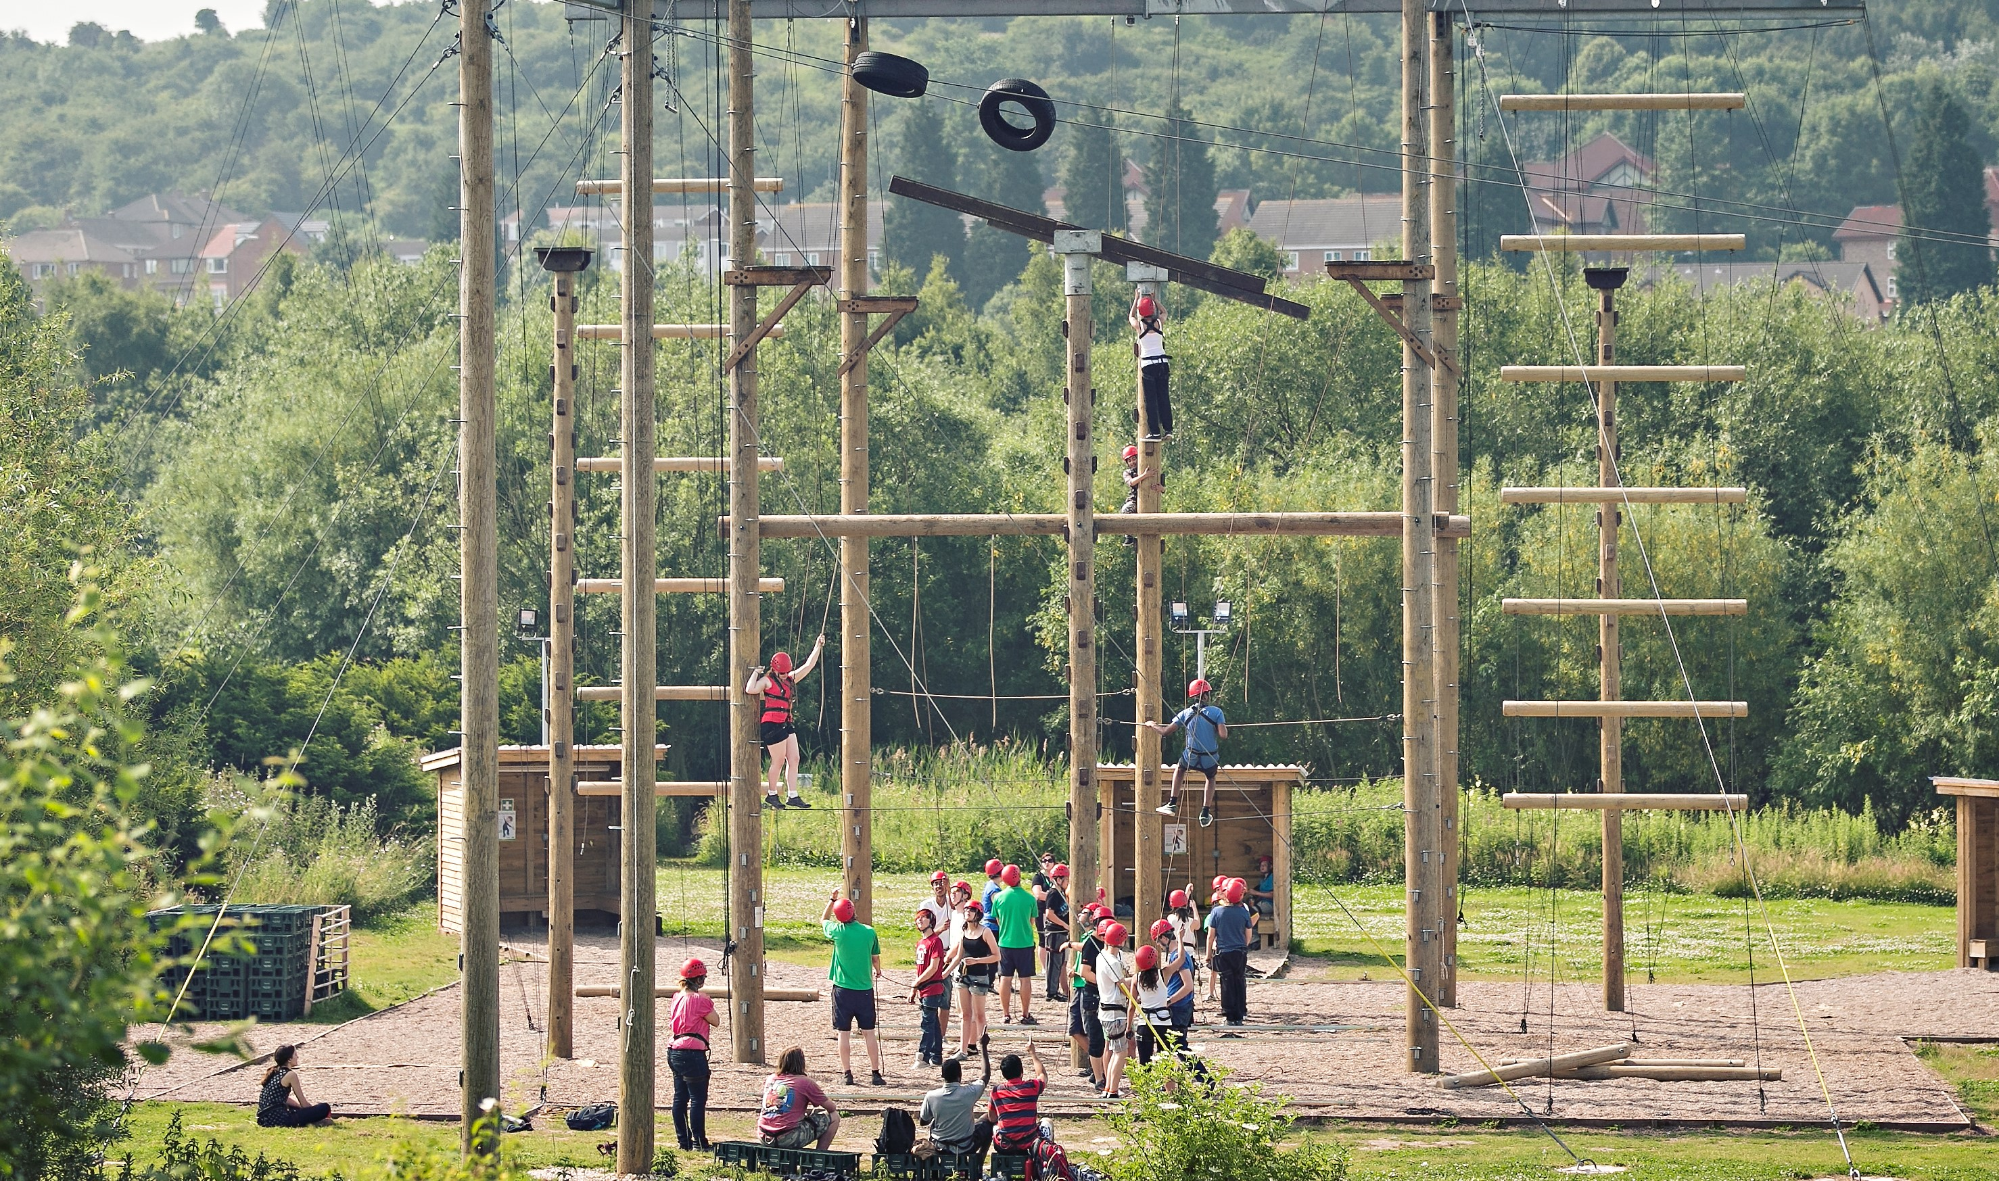
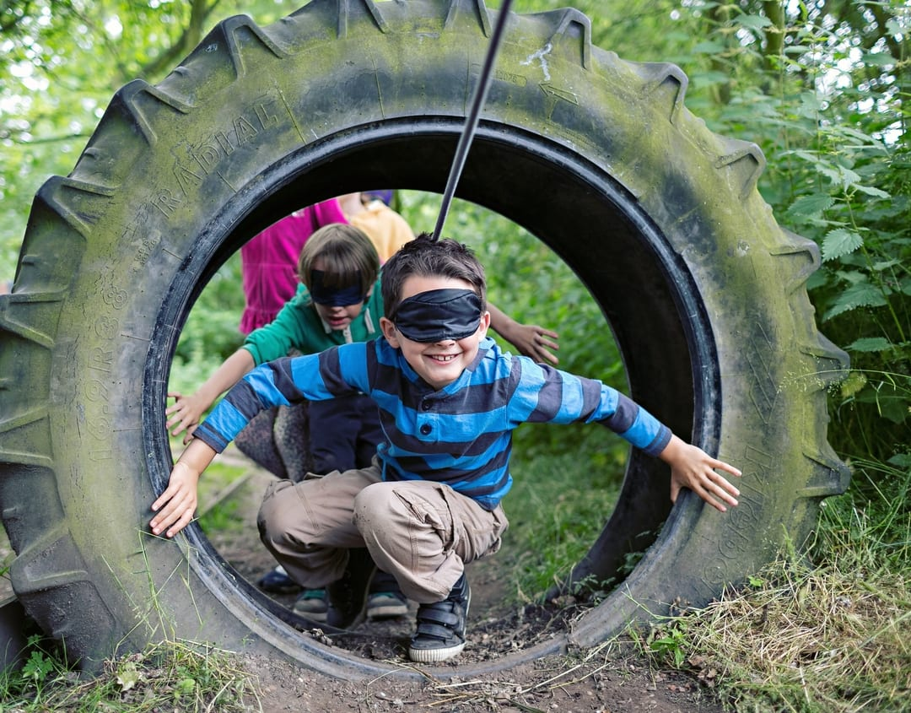
Children will get to participate in a variety of new and exciting challenges to encourage teamwork, problem-solving and excitement.
This year, they will include orienteering, raft building and abseiling,.
(Activities are subject to change).
No child will be made to endure something that they are not happy to complete. Children will be encouraged to challenge their upper limit but of course, the option to sit out and encourage others is there.

Slide 7
Parent Information
Arrive at school for 8.50am not in school uniform
Depart school about 9:15am on the Wednesday
Packed lunch required, eaten at Conisburgh Castle
Arrive back at school around 2:30pm on the Friday
Parents may collect at 3:00pm if you wish, normal closing time at 3:30pm
Staff attending – Mr Brown and Miss Balderson
First Aider – Mr Brown
Buffet menu every day, a good variety to choose from
Secure site, when group leaders finish for the day, a security-guard team take over

Slide 8
Information
Water bottle
Long sleeves and long trousers
Long hair tied back
No jewellery
Indoor shoes for dormitory
Roll on deodorant – no aerosols
No electronics – no phones/I-pads/airtags/cameras etc
All medication to be handed to Mr Brown/school in advance – none to be put into bags
Up to £10 for the gift shop (named purse or wallet handed to Mr Brown)
Regular updates sent through school comms

Slide 9
Bedtime
Shower, teeth cleaned and bed around 9.30ish
Lights out around 10:15pm
Up at 7am each morning
Any questions, please refer to Mr Brown, who has been to the site 8 times with 3 different schools.

Slide 10
Clothing Kingswood list - enough for 3 days
ESSENTIAL kit for OUTDOOR Activities
Pair of trainers for land sessions and a spare pair for the raft building, which will get wet
Long trousers – tracksuit, fleece and poly-cotton are great - Jeans may be suitable
Warm long-sleeved tops – fleece is best, or wool, acrylic or poly-cotton
Plenty of T-shirts
Socks and underwear for 4 days
Water bottle (named, if possible)
ESSENTIAL personal kit
Wash kit and towels – shower gel, shampoo – roll-on deodorants
Toothbrush & toothpaste
Hairbrush (and bobbles)
Pyjamas
A bath towel
Plastic bag for laundry
Sun cream/sun hats/sunglasses

