Slide 1
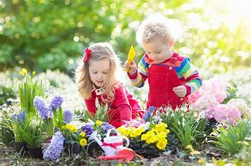
Gardeners and Caretakers of the World
Wrawby Representatives (Y4/5)
30th April 2025

Slide 2
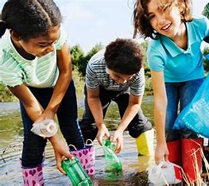
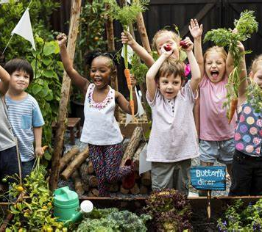
What do we mean by ‘Gardeners and Caretakers of the World?’
Being a gardener and caretaker of the world isn’t necessarily actually doing gardening. It is helping to save the environment by, for example, picking up litter or recycling. Everyone can be a gardener and caretaker of the world we live in today.

Slide 3
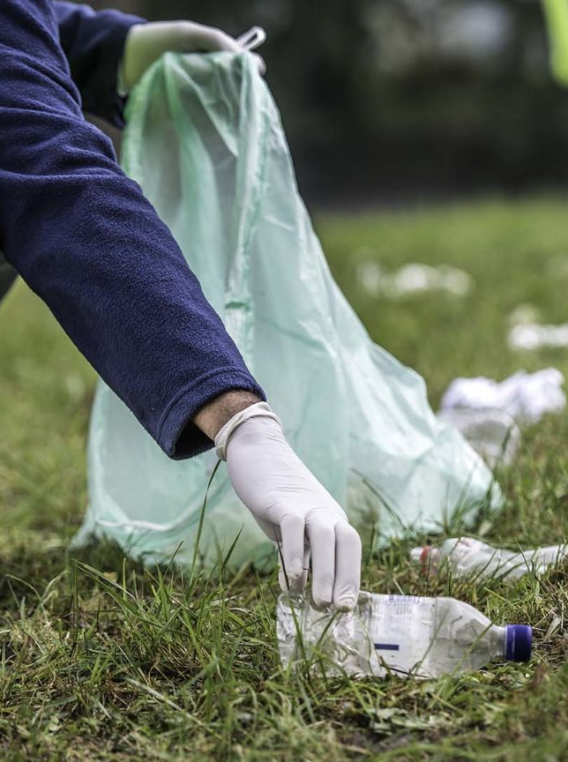
We all have to do our part
We all have to help the environment. It doesn’t have to be something big, it could be something as small as putting things in the correct recycling bins. Or it could be going out litter picking once in a while, inspired by James.

Slide 4
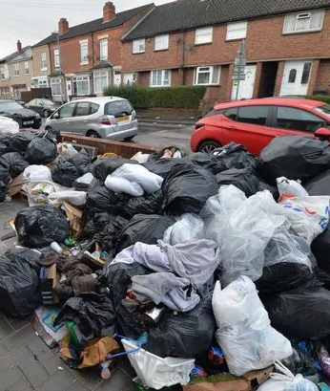
If you think someone else will do it, it may never happen
Don’t ever think that somebody will save the planet for you (because they wont). We all need to be gardeners and caretakers of the world.

Slide 5
The Bible
Genesis 2:15
‘The Lord God took the man and put him in the garden of Eden to work it and keep it.’
Job 12:7-10
‘But ask the beasts, and they will teach you; the birds of the heavens, and they will tell you; or the bushes of the earth, and they will teach you; and the fish of the sea will declare to you. Who among all these does not know that the hand of the Lord has done this? In his hand is the life of every living thing and the breath of all mankind.’
Psalm 115:16
The heavens are the Lord's heavens, but the earth he has given to the children of man.

Slide 6
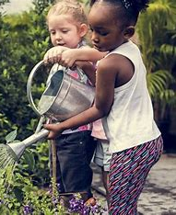
What could you do today?
In your free time, you could maybe go out litter picking with your family and friends as a fun activity (which will also help the planet!)
Another thing that you can do at home is take the bins out for your parents. Or you can do a fun game of who can collect the most rubbish and put them in the correct bins.

Slide 7
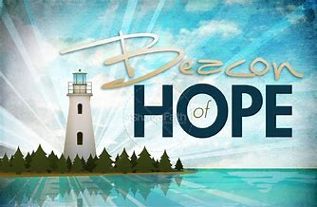
Time to reflect, time to pray
Dear God,
Thank you for nature in all of its beauty. Your kingdom, your garden, is for every child to share. Help us to take good care of all the plants and animals that live here with us.
May we be a beacon of hope in our school and wider community.
Amen.

