Slide 1

Maths
Times tables parent meeting

Slide 2
On Friday we re-launched TTRS-
There is a variety of different games that the children can engage in on this platform:
From trying to increase their rockstar status
Beat the clock
Challenge a friend (or a teacher)
Gigs
Play multiplayer
Complete in battles set by teachers.
For 100 points scored in a week= 1 merit

Slide 3

Why do we need to teach times tables
Place value
Algebra
Four operations
Ratio
Shape
Measurement
Statistics
Fractions, decimals and percentages

Slide 4
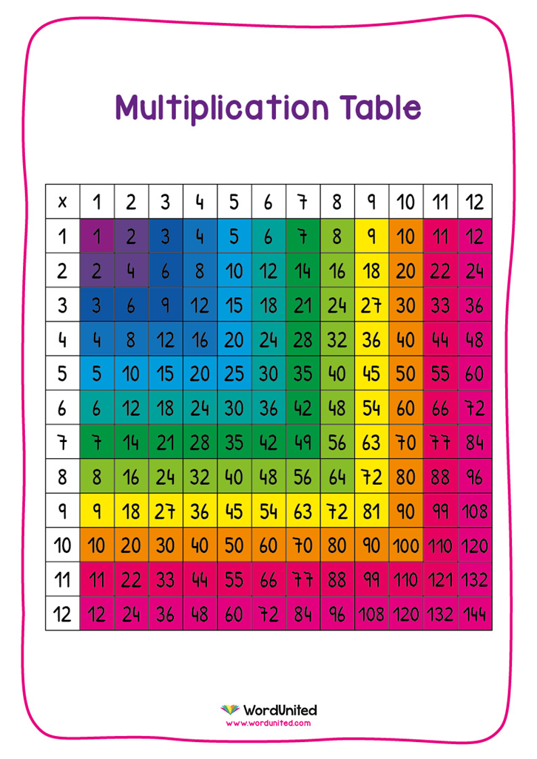
At the end of Year 4, the children are expected to know all their times tables to 12 x 12, as well as the division facts.

Slide 5
The Multiplication tables check (MTC)
TTRS- Single player- Soundcheck (beat the clock) is an example of the MTC.
We are teaching the children to let the clock run down, this will give more thinking time.

Slide 6
At home, children can use:
- TTRS
-timestables.co.uk
- listen to times tables songs

