Slide 1
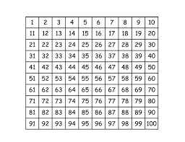
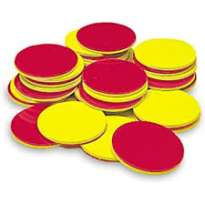
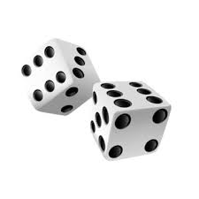
Count Backwards
You will need:
How to play:
Find the number 50 on your hundred square.
Roll your dice and count back that number on your hundred square.
Put your counter on your new number.
Take turns.
First person to 0 wins!

Slide 2
Count Forwards
You will need:
How to play:
Find the number 50 on your hundred square.
Roll your dice and count forward that number on your hundred square.
Put your counter on your new number.
Take turns.
First person to 100 wins!

Slide 3
Don’t Roll a 6!
You will need:
How to play:
Start at 0 on your hundred square.
Take turns to roll your dice.
Move your counter that many spaces.
Say the number you land on.
When you roll or your partner roll a 6 the game is over.
Highest score on the hundred square is the winner.

Slide 4
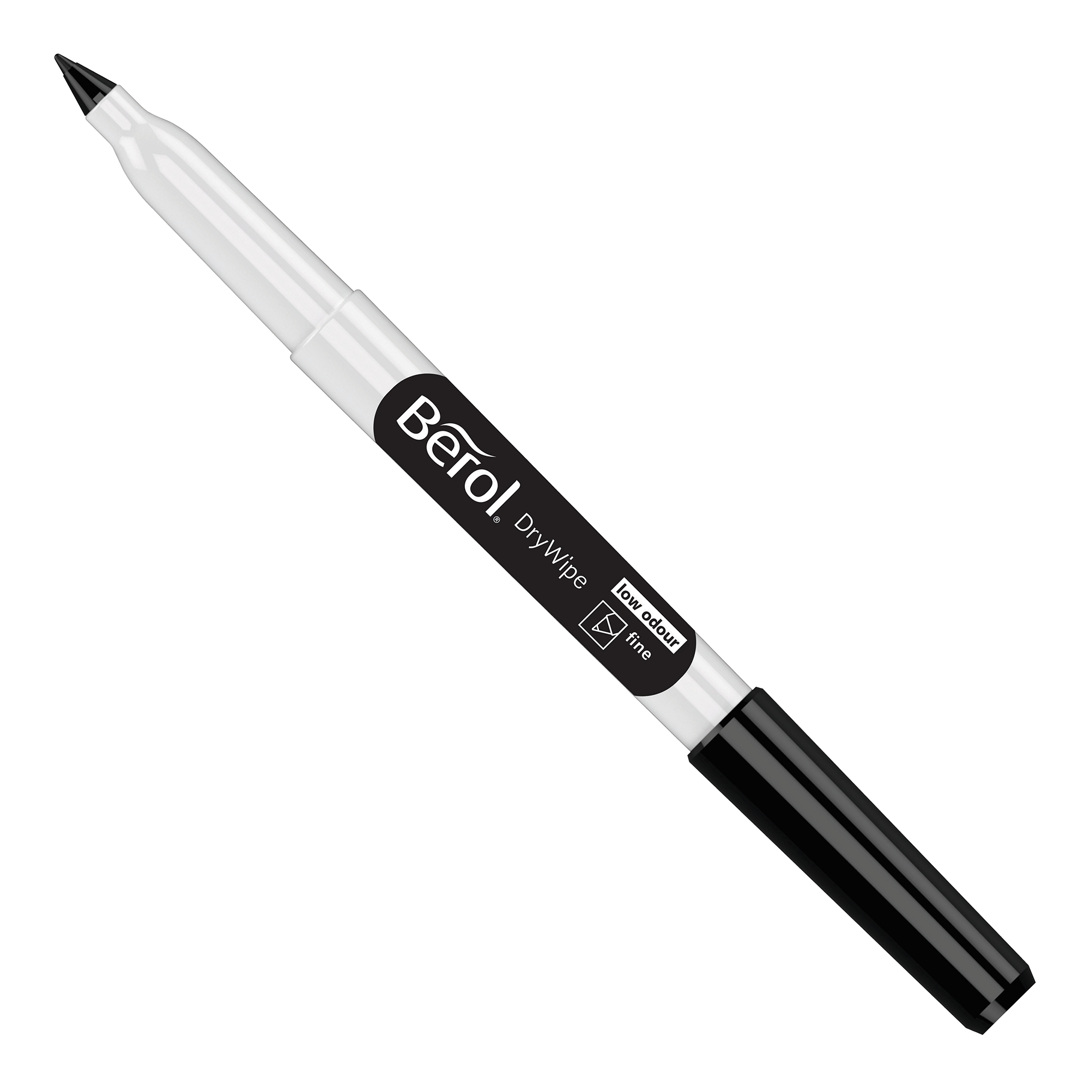
Connect four!
You will need:
How to play:
Roll 2 dice. One will be the tens, one will be the ones.
Choose the number you wish to cross out (e.g. throw a 2 and 3 choose to cross out 23 or 32)
First person to get 4 numbers in a row is the winner.

Slide 5
Beat That!
You will need:
How to play:
Roll the dice and put them in order to make the highest number possible. If you roll a 4 and a 6, for example, your best answer would be 64.
Your partner will roll the dice.
Roll again and add you previous score to your new score. First person to reach 500 wins!
Player 1 | Player 2

Slide 6
Going to Boston!
You will need:
How to play:
Roll the dice and keep the highest. Roll the remaining dice and again set aside the highest. Roll the last die and add up your total. Write down your score.
Person with the highest score wins that round.
Player 1 | Player 2

Slide 7
Dice Difference.!
You will need:
Write the numbers 1-5 on your WB
How to play:
Roll the dice.
Work out the difference and cross it out on your board.
First person to cross out all of the numbers is the winner.
1 | 2 | 3 | 4 | 5

Slide 8
Nice or Nasty!
Target:
You will need:
Draw 4 boxes on your WB.
How to play:
Take turns to roll the dice.
Fill each number into your four boxes.
Person closes to our target number is the winner.

Slide 9
Top Dog!
Target:
You will need:
Keep a tally of your points on your WB.
How to play:
Take turns to roll the dice.
Person who scores the highest total scores a point.
First person to 5 points wins.

Slide 10
Hang House.
You will need:
A mini whiteboard.
How to play:
One person chooses a number.
Your partner has to guess your number by asking questions (e.g. Does it have 5 tens?)
For each incorrect guess your partner draws one line of the house.
You win if you guess the number before the house is drawn.

Slide 11
Coins in a Jar.
You will need:
A jar.
Coins
How to play:
Get the children to close their eyes.
Get them to keep count of the coins (1p, 2p, 5p, 10p) by listening to them drop.

Slide 12
Clap, Clap, Click
How to play:
Claps are tens
Clicks are ones
Listen carefully.
What number have I made?
Invite children up to have a go.

Slide 13
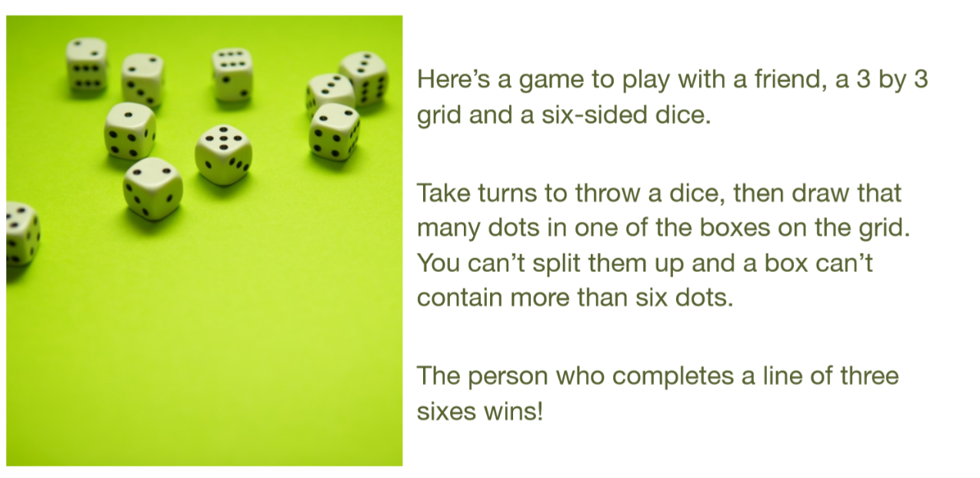
Dotty Six. (https://nrich.maths.org/7337))

