Slide 1
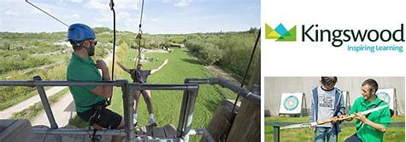

Kingswood 24th-26th May 2023
Depart school at 9:15am
https://www.youtube.com/watch?v=gyuMDITz1d8

Slide 2
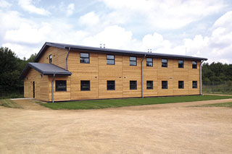
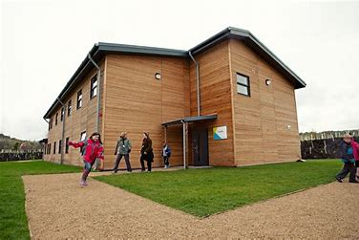
Your home: secure dorms

Slide 3
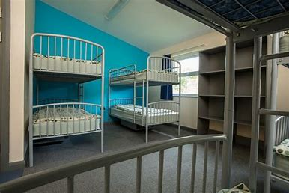
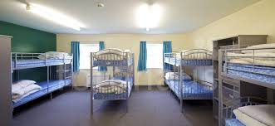
Bedrooms sleep up to 10

Slide 4
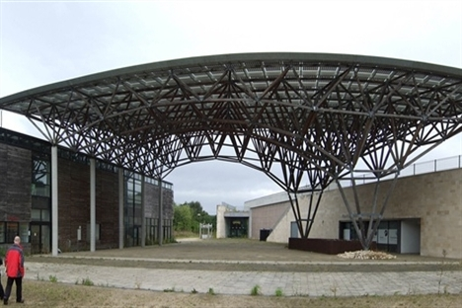
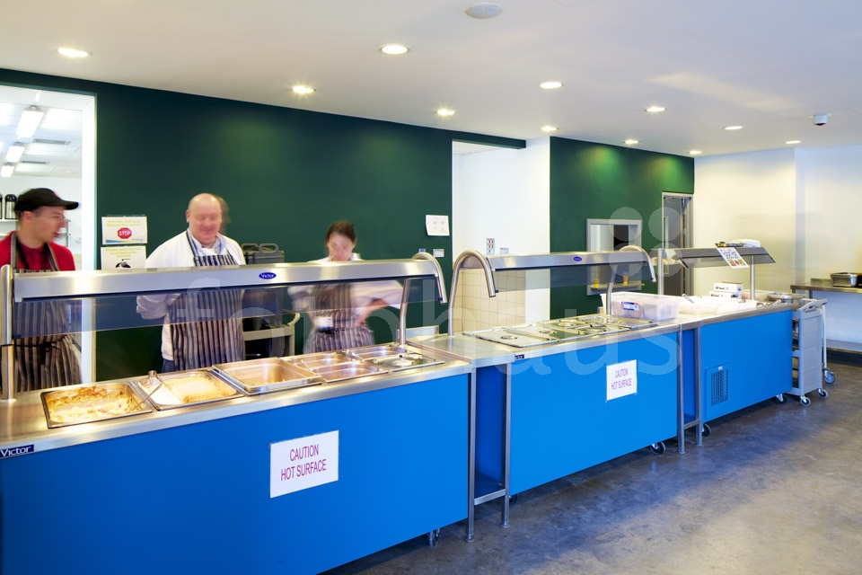
Dining Hall
3 meal choices

Slide 5
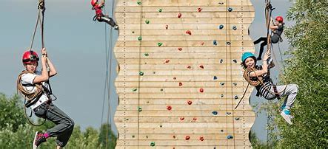
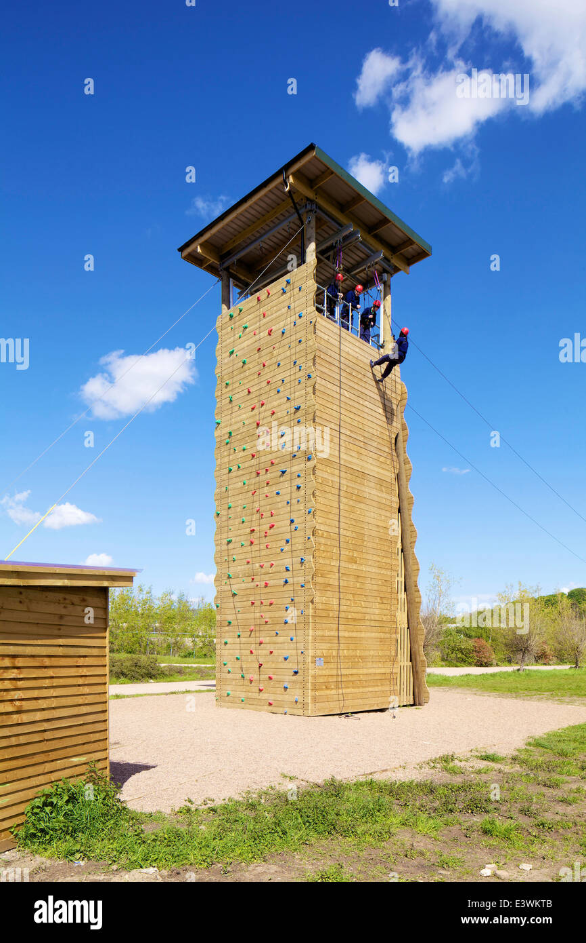
Activities
Adventure
Team work
Challenge
Fun

Slide 6
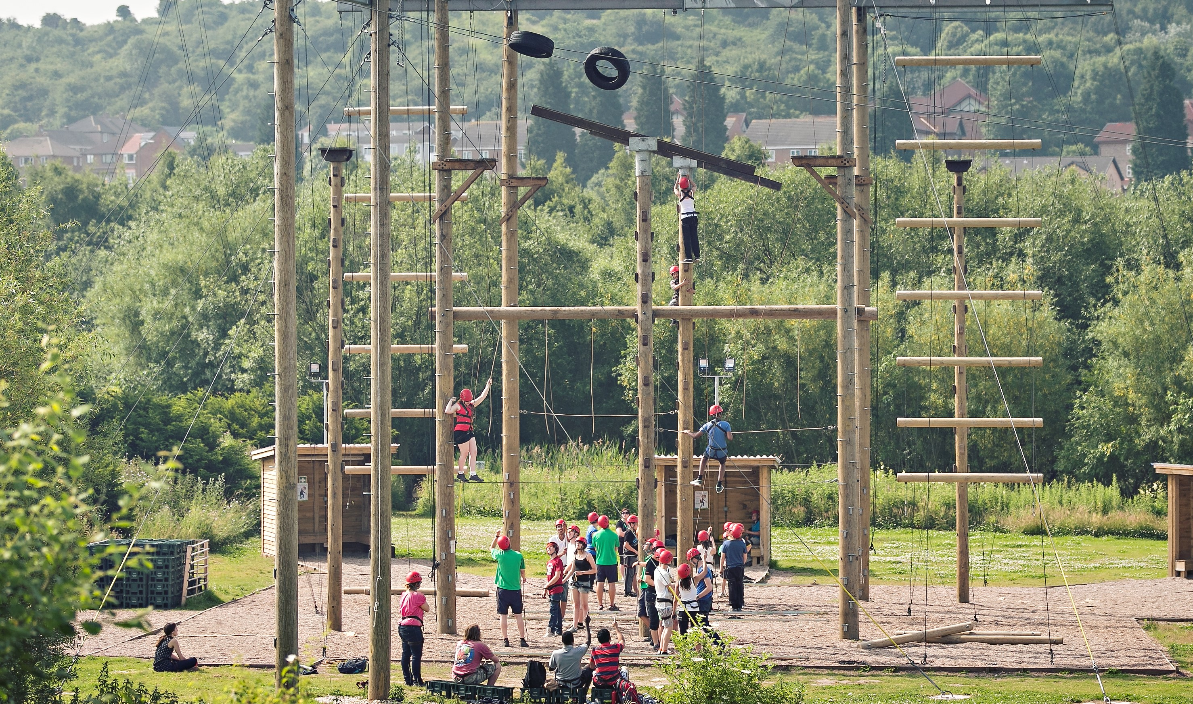
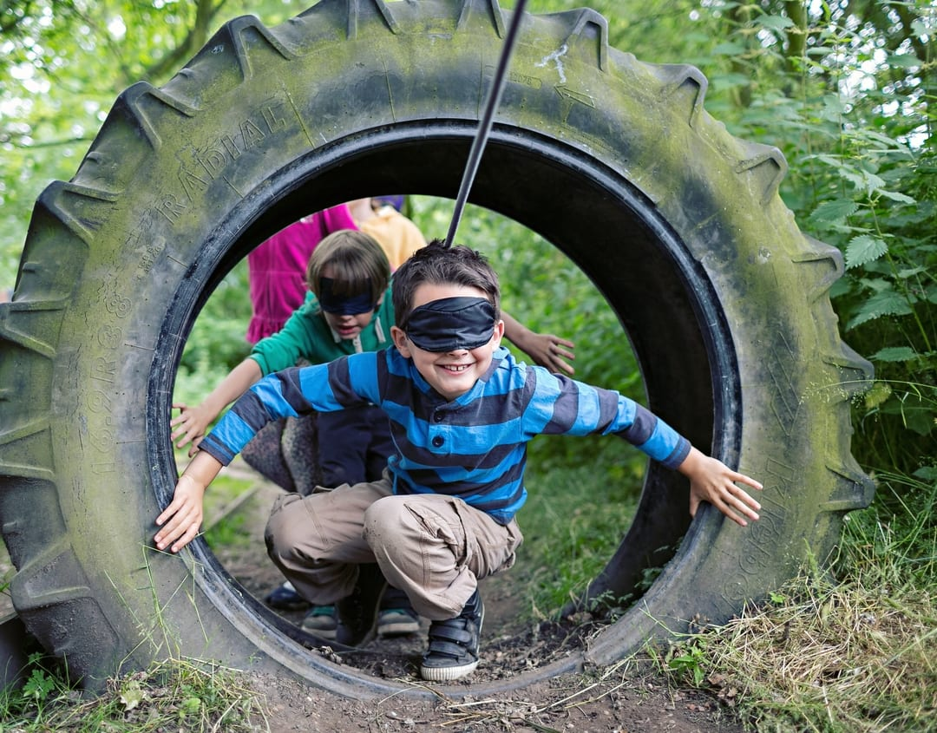
Children will get to participate in a variety of new and exciting challenges to encourage teamwork, problem-solving and excitement.
This year, they will include buggy building, night walk, raft building, abseiling, climbing wall and the scrapheap challenge. (Activities are subject to change).
No child will be made to endure something that they are not happy to complete. Children will be encouraged to challenge their upper limit but of course, the option to sit out and encourage others is there.

Slide 7
Parent Information
Arrive at school for 8.50am not in school clothes
Depart school about 9:15am
Packed lunch required, eaten at Doncaster Minster
Arrive back at school around 2:30pm on the Friday
School opening gates to parents at 3pm for the final 1-mile a day charity challenge
Staff attending – Mr Brown, Mr Matthews, Miss Balderson and Mrs Robson
First Aider – Mr Brown
Buffet menu every day, a good variety to choose from
Secure site, when group leaders finish for the day, a security-guard team take over

Slide 8
Information
Water bottle
Long sleeves and long trousers
Long hair tied back
No jewellery
Indoor shoes for dormitory
Roll on deodorant – no aerosols
No electronics – no phones/Ipads, cameras etc
All medication to be handed to Mr Brown/school in advance – none to be put into bags
Up to £10 for the gift shop (named purse or wallet handed to Mr Brown)
Regular updates sent through school comms

Slide 9
Bed time
8-bedded room for 6 boys
8-bedded room for 4 boys
10-bedded room for 8 girls
Staff bedrooms on the same floor
Shower, teeth cleaned and bed around 9.30ish
Up at 7am each morning

Slide 10
Clothing Kingswood list - enough for 3 days
ESSENTIAL kit for OUTDOOR Activities
Pair of trainers for land sessions
Long trousers – tracksuit, fleece and poly-cotton are great - Jeans may not be suitable
Warm long-sleeved tops – fleece is best, or wool, acrylic or poly-cotton
Plenty of T-shirts
Socks and underwear for 3 days
Water bottle (named, if possible)
ESSENTIAL personal kit
Wash kit and towels – shower gel, shampoo – roll-on deodorants
Toothbrush & toothpaste
Hairbrush (and bobbles)
Pyjamas
A bath towel
Plastic bag for laundry
Sun cream/sun hats/sunglasses

